Slide 1
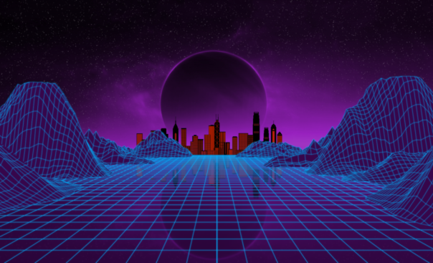
METAVERSE
Presented by :
Jambukiya Harsh Sureshbhai(19BECE30062)
Parmar Ravi Vipulbhai(19BECE30562)
Vyash Pragvansh Nimishkumar(19BECE30142)
Joshi Meet Dipakkumar(19BECE30547)
Guided by :
Prof. Lokesh Gangnani

Slide 2
WHAT IS METAVERSE ? METAVERSE → Beyond universe metaverse is simply defined as a virtual world where people can socialize , work and play. The Metaverse is not future .it is already here it is a conversation about becoming not simply being. By Metaverse we can make a place where you relax in public, where you encounter familiar faces.

Slide 3
Potential positives of metaverse : 1. experience 2. Expression 3. teleportation 4. knowledge and study 5. fast and improved productivity 6. safe environment 7. new economy

Slide 4
Potential Negatives of metaverse : 1. addiction 2. depression 3. data and security 4. denying reality 5. Moderation

Slide 5
Some myths and reality about metaverse :
Myth-1 You need a virtual reality helmet to access the metaverse.
REALITY : you can use tools what you already have like desktop computer or smartphone.
Myth-2 The metaverse is just a gaming world and has no real world uses.
REALity : people are already using for work and increase their income.
Ex. Componies like pricewater house cooper and prager metrishave opened metaverse branches so they can be there where their clients are.
Myth-3 Investing in the metaverse is a surefire way to lose money.
Reality : Virbela has been around since 2012 . An impressive feat, but there are other plateforms lasted even longer.
Second life is probably the best example of early metaverse that’s still in operation and has active uses who buy and sell metaverse real estate .it was founded in 2003 and still has 2,00,000 active users visiting daily.

Slide 6
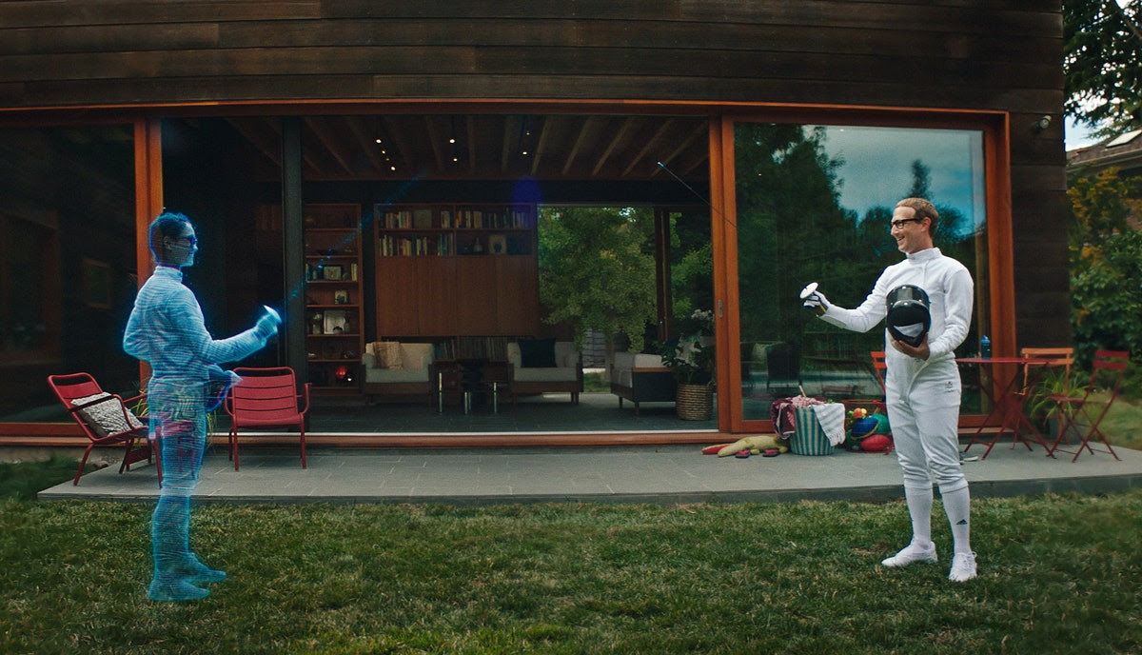
Popular companies that are building the future of metaverse : 1. epic games 2. nike 3. Microsoft 4. Nvidea 5. Facebook (meta)

Slide 7
facebook in meta technology … Facebook is at top of in race by changing its name to meta and is now experimenting with the metaverse technology. Meta’s ambition are to transform routine living from building 3D work rooms. Facebook also said “ meta is not going to build ,run or own the metaverse on its own .we are starting conversation about our vision for the metaverse early before some of the technologies even exist… wr’re are discussing now on ensure privacy controls and safety features are appropriate to the new technologies and effective in keeping people safe. the company putting some of the brightest engineering minds in the world to work on this project, hiring over 10,000 people to work this project.

Slide 8
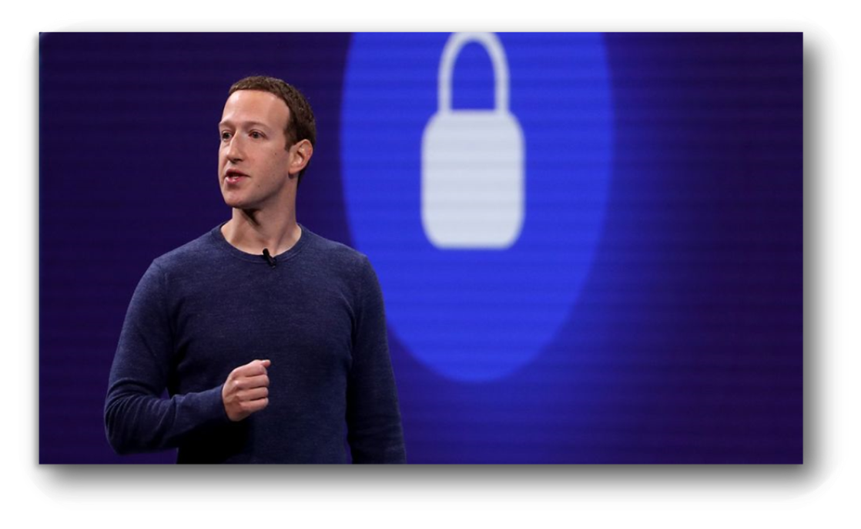
Mark Zuckerberg ,CEO OF FACEBOOK
I belives Metaverse is the future of the internet and of my trillon dollor company.

Slide 9
Some Real life Examples of Metaverse :
ON 6th FEB COUPLE FROM TAMILNADU MARRIED ON METAVERSE. IN THIS MARRIAGE FATHER OF GIRL WHO PASSED AWAY , WAS ATTENDED MARRIAGE IN VIRTUAL WORLD AND GAVE BLESSING TO HER DAUGHTER.
IN 2020,AT SOUTH CORIA A MOTHER MET HER 7 YEARS OLD DAUGHTER , WHO PASSED AWAY 4 YEARS AGO. SHE MET HER, TOUCH HER. UNIVERSE WAS VIRTUAL BUT THE TEAR OF MOTHER WAS REAL.
CARABION COUNTRY BABADOS GAVE WORK TO A COMPANY TO ESTABLISH EMBASSY IN VIRTUAL WORLD .FOR THAT GOVERNMENT ALREADY BOUGHT PLACE FOR IT.

Slide 10
AMERICAN GIRL WENT TO WALK IN VIRTUAL WORLD BY WEARING HEADSETS .AT THAT TIME A BOY CHASING THE GIRL AND MISBEHAVE WITH HER. WHEN GIRL OPPOSE IT THEN HE SAID IT IS METAVERSE .HERE ANYTHING CAN BE DONE, YOU CAN’T STOP ANY ACTIVITY.
IT IS NOTED AS FIRST CRIME OF VIRTUAL WORLD.
AFTER THAT METAVERSE ADDS PERSONAL BOUNDARY FEATURE TO STOP VIRTUAL HARASSMENT.

Slide 11
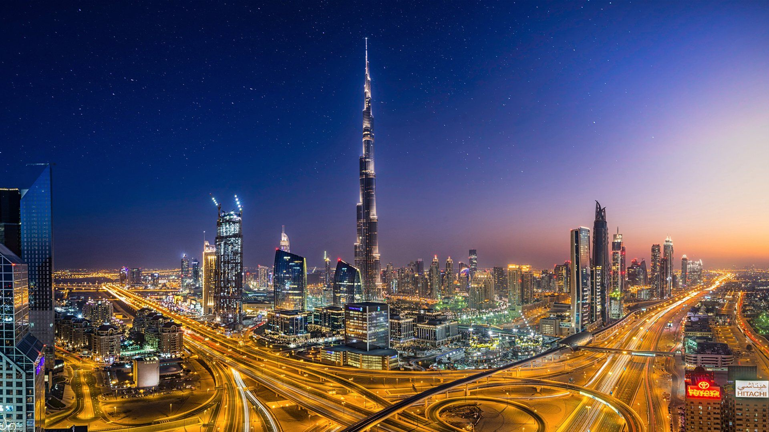
The metaverse is not “a” metaverse .It is the next generation of the internet.it is a multiverse led by a new and abundant generation of creators.
The metaverse is not “a” metaverse .It is the next generation of the internet.
It is a multiverse led by a new and abundant generation of creators.

Slide 12
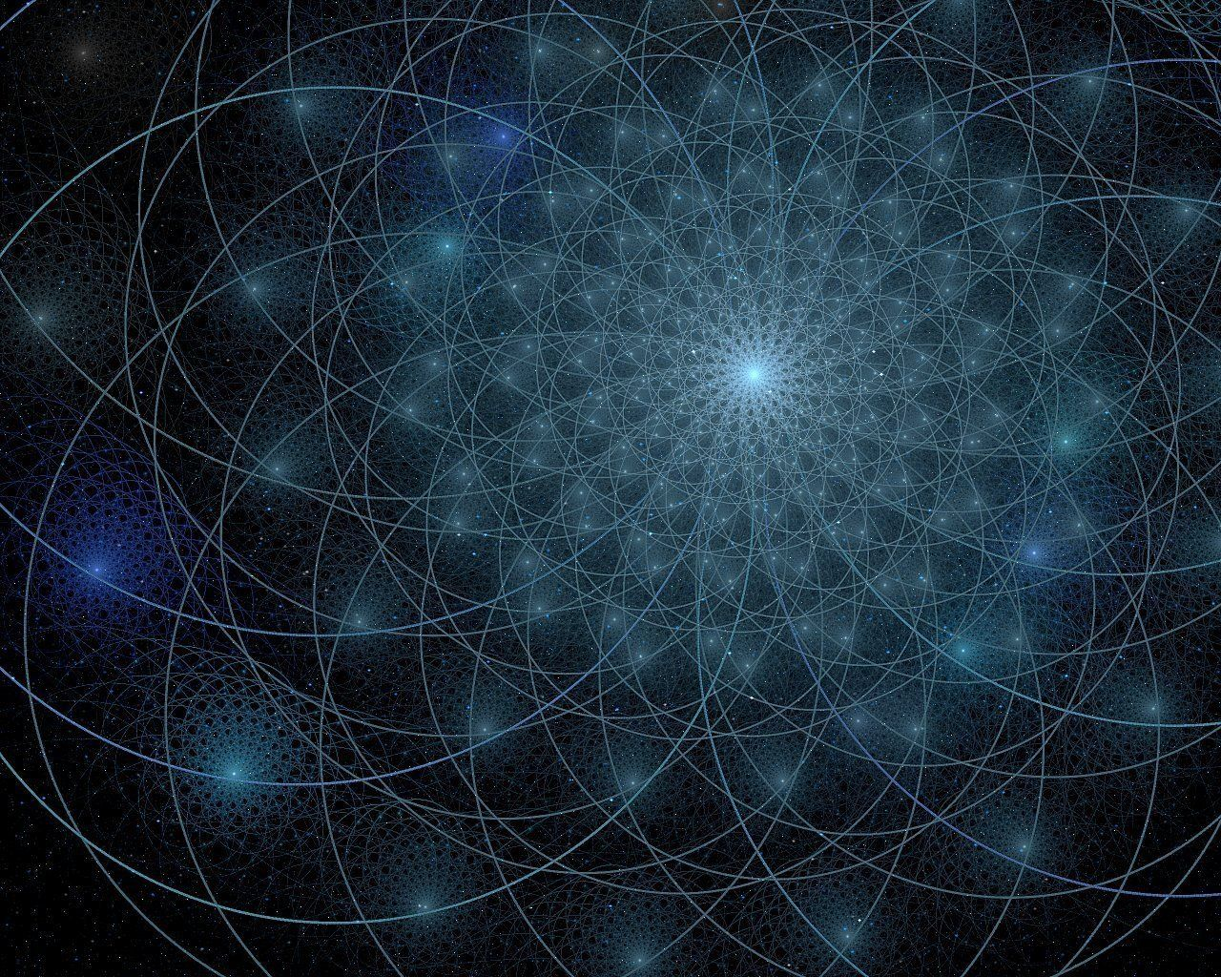
Thank you !!
This Photo by Unknown Author is licensed under CC BY-NC-ND

